Slide 1
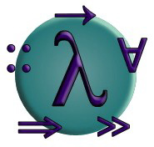
PROGRAMMING IN HASKELL
Introduction

Slide 2
The Software Crisis
How can we cope with the size and complexity of modern computer programs?
How can we reduce the time and cost of program development?
How can we increase our confidence that the finished programs work correctly?

Slide 3
Programming Languages
One approach to the software crisis is to design new programming languages that:
Allow programs to be written clearly, concisely, and at a high-level of abstraction;
Support reusable software components;
Encourage the use of formal verification;

Slide 4
Programming Languages
Permit rapid prototyping;
Provide powerful problem-solving tools.
Functional languages provide a particularly elegant framework in which to address these goals.
3

Slide 5
What is a Functional Language?
Opinions differ, and it is difficult to give a precise definition, but generally speaking:
Functional programming is style of programming in which the basic method of computation is the application of functions to arguments;
A functional language is one that supports and encourages the functional style.

Slide 6
Example
Summing the integers 1 to 10 in Java:
total = 0;
for (i = 1; i ≤ 10; ++i)
total = total+i;
The computation method is variable assignment.
5

Slide 7
Example
Summing the integers 1 to 10 in Haskell:
sum [1..10]
The computation method is function application.
6

Slide 8
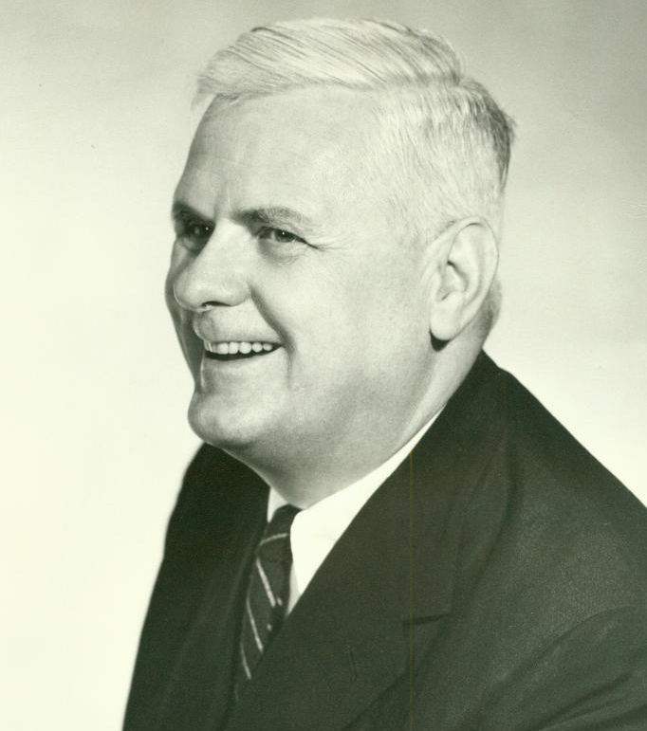

Historical Background
1930s:
Alonzo Church develops the lambda calculus, a simple but powerful theory of functions.
7

Slide 9
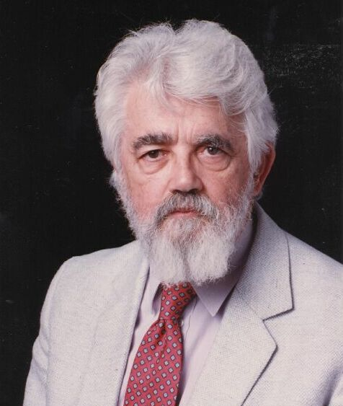
Historical Background
1950s:
John McCarthy develops Lisp, the first functional language, with some influences from the lambda calculus, but retaining variable assignments.
8

Slide 10
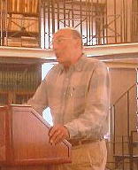
Historical Background
1960s:
Peter Landin develops ISWIM, the first pure functional language, based strongly on the lambda calculus, with no assignments.
9

Slide 11
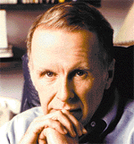
Historical Background
1970s:
John Backus develops FP, a functional language that emphasizes higher-order functions and reasoning about programs.
10

Slide 12
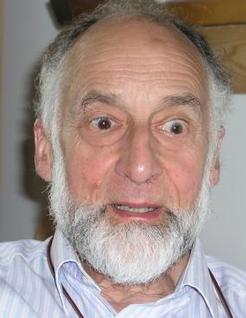
Historical Background
1970s:
Robin Milner and others develop ML, the first modern functional language, which introduced type inference and polymorphic types.
11

Slide 13

Historical Background
1970s - 1980s:
David Turner develops a number of lazy functional languages, culminating in the Miranda system.
12

Slide 14
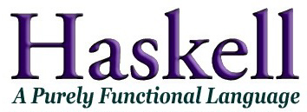
Historical Background
1987:
An international committee of researchers initiates the development of Haskell, a standard lazy functional language.
13

Slide 15
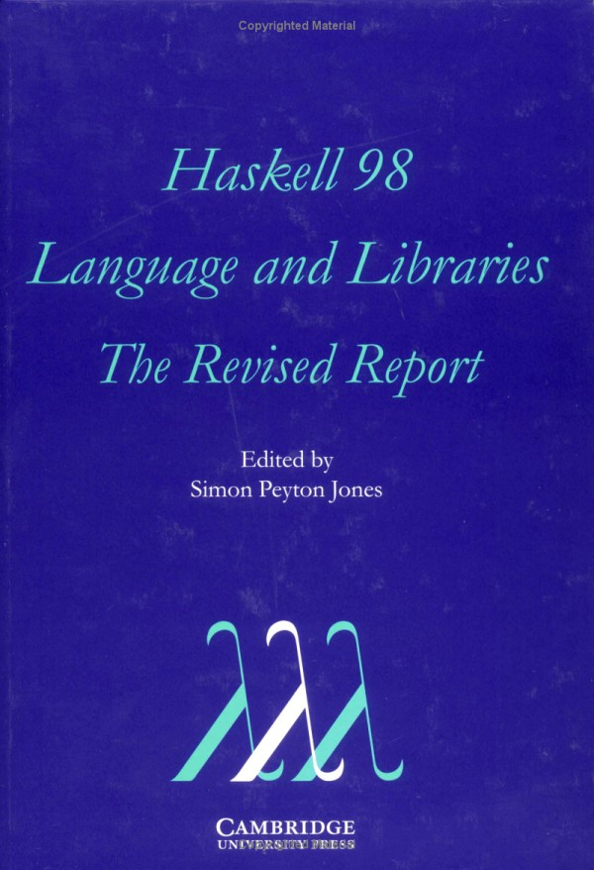
Historical Background
2003:
The committee publishes the Haskell 98 report, defining a stable version of the language.
14

Slide 16
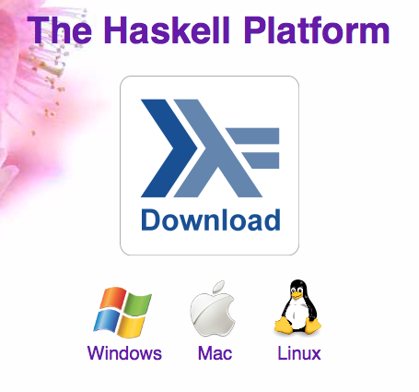
Historical Background
2003-date:
Standard distribution, library support, new language features, development tools, use in industry, influence on other languages, etc.
15

Slide 17
A Taste of Haskell
f [] = []
f (x:xs) = f ys ++ [x] ++ f zs
where
ys = [a | a ← xs, a ≤ x]
zs = [b | b ← xs, b > x]
?
16

